Slide 1
Museum of the Resistance
During the Second World War Lyon was one of the few cities not having been occupied by the Germans in the early stages of the conflict in France This made it a bastion of the French Resistance. The Resistance Museum pays tribute to this story. It lies within what was once the headquarters of the Gestapo.

Slide 2
The Centre d’ Histoire de la résistance et de la déportation (CHRD), located in avenue Berhelot 14 in Lyon, is the amount of an Italian Institute of the History of the Resistance. A part of the center has been turned into a museum of Resistance and Deportation. Located on the old site of the Ecole de Santé Militaire (Military School of Health), the CHRD was occupied in the spring of 1943 by the Gestapo led by Klaus Barbie and it was a witness to the Nazi barbarism (in fact the prisoners and members of the resistance were tortured, There was Jean Moulin between them). After the destruction by Allied hands in May 1944, it was only in October 1992 that the Museum and the true bibliographic center were opened.

Slide 3
LYon during the war
During the Second World War, Lyon saw a mix of destinies. Situated in the Southern zone, in accordance with the 22nd June 1940 armistice, it became the most important city of Free France. It fulfilled a major role with the redeployment of administrative services and press organs from Paris. As an important intellectual hotbed, Lyon saw numerous leaflets and clandestine newspapers begin to appear since the summer of 1940. At the same time, the civil and military Resistance began to be organized.
On the 11th November 1942, the situation changed radically: German troops invaded the Southern zone and occupied the city. The German repressive services and the Vichy auxiliary police tracked down the members of the resistance and made many arrests. The repression also descended on the Jews, and many roundups were organized since August 1942.
On the 14th September 1944, General de Gaulle paid tribute to the city's commitment, during a speech at the City Hall, and he proclaimed Lyon "Capital of the Resistance".

Slide 4
The project for creating the History Centre owes a lot to the eyewitnesses, who are still strongly involved in its working life today.
The History Centre is a place where memories are handed down and generations can meet. Former members of the resistance and/or deportees, "hidden children" of deportees, actors and eyewitnesses of the Second World War come every day to tell their story and talk with the young and their teachers.

Slide 5
DEPORTED
Family Zajtman
Family Kadoshe

Slide 6
The declaration of war from Italy to France resulted in renewed tension in Lyon, marked by demonstrations and the sacking of shops. A call from the prefect Bollaert invites the Lyonnais to calm, promising them measures of retaliation against the suspect Italians.

Slide 7
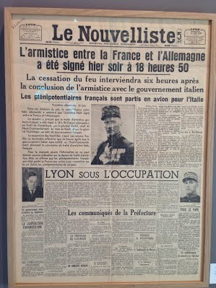
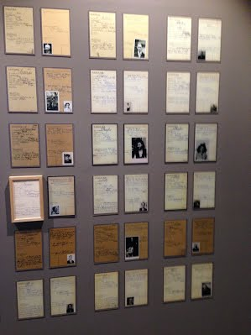
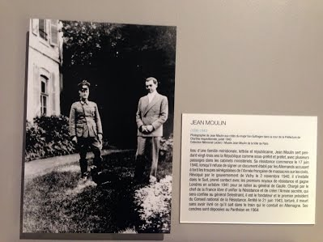
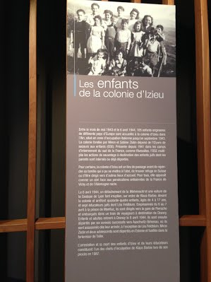
“Memory is the root of deliverance as oblivion is that one of exile”
“If the echo of their voices weakens, we will perish”
“Those who do not remember the past are condemned to relive it”

