Slide 1
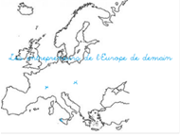
CROATIAN ECONOMICS INDICATORS
PROJECT: EUROPEAN ENTREPRENEUERS OF TOMORROW
ACTION 4

Slide 2
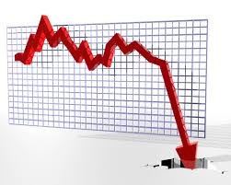
Where is the problem?
2015`s top 15 economies with slowest growth
reasons: longterm recesion and high unemployment rate

Slide 3
Economic state of mind in Croatia (in %)
economic weakness and apathy 42%
economic depression 16%
fear of economic disaster 14%
fear of economic breakdown and failure 7%

Slide 4
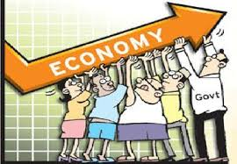
Recovery on the horizon...
GDP (2015.) → 89,76 billion USD
BDP grows 3rd quartal in a row (in second three-month period it grows for 1,2%)
BDP/per capita→ 20.873,00 USD
inflation→ 0,7%
industrial production→ 1,9% higher than year before
private consumption (May 2015.)→ increased for 4,1%

Slide 5
unemployment
17,5% (April 2015.) → lower during the tourist season
building industry
1,2% growth
business climate→ the most positive since Croatia became a part of EU

Slide 6
Industry
Main industries:
chemical industy
metallurgy
electronics
wood industry
construction materials
textile
shipbuilding
oil
food industry
tourism
25% of workers are employed in industry
83% industry – manufacturing industry
2014. – growth of industrial production by 1,3%
May 2015. – Croatia was among EU countries with highest industrial production growth

Slide 7
Export goods:
transport units
machines
textile
chemicals
food
fuel
export: 12.37 billions USD
Import goods:
machines
transport and electrician equipment
chemicals
fuel
food
import: 20.98 billion USD

Slide 8
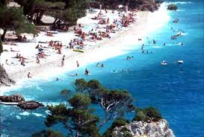
Tourism
very important for Croatia
world`s no.18 tourist destination
first half of 2015. – incomes: 2.278 €
- 7% more tourists i 4,7% more overnight stays

Slide 9
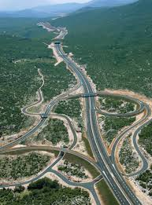
Other
Traffic – good geography positon– land, water and air traffic
Trade
business for 38% economic subjects
15% employed workers
37% of total income and 17% of total investments
oil and gas

Slide 10
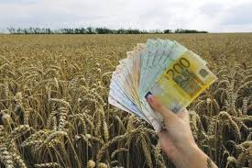
3,15 mil hectars of agriculture area– 2 mil. are processed
cattle, poultry and sheep
kulen, pršut, cheese and wine
agriculutre, forestry and fishing – 7,2% of GDP

Slide 11
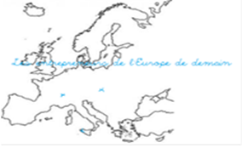
Created by:
ERASMUS+ project „European entrepreneuers of tomorrow” Croatian action 3 team

